Slide 1
Fluke – Demand Forecasting Queries & Approach

Slide 2
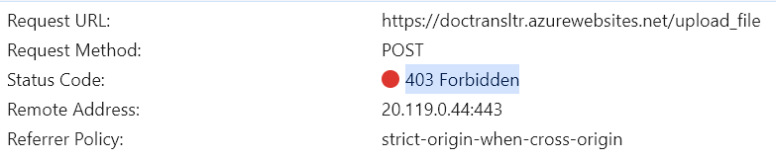
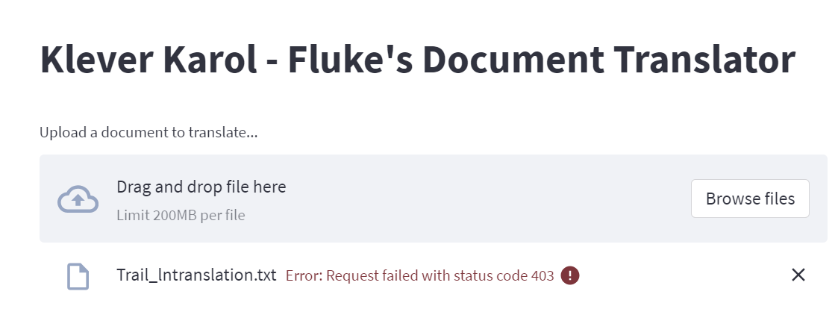
12-Mar-24
We have configured in the App service.
Figuring out how the token is to be provided streamlit to allow the user to upload a file.
Currently we are getting this error
Raja and team has implemented this in Flask, where as our application is in Streamlit

Slide 3
5-Mar-24
Now the application is loaded with Vietnam’s
Translation Memories : store records of all translations completed
The users would like the tool to store records of all translations completed and ‘Learns’ from the history
Need one session on .indd files, how they look like and how to opne them
We were asked to add some more features to techsupportGpt
Arrange a session to show the INDD files.

Slide 4
Today's call check which metric they are looking for
7Pm call with Kyle - Need signoff by this weekend
Weekly metrics..
We already provided for number of documents. They asked for filename, Source language and target language, extension, size and time stamp.
They have to prepare a report from that with the Power BI guy.
It includs MB. We can add one more column of usage of the Azure translator service

Slide 5
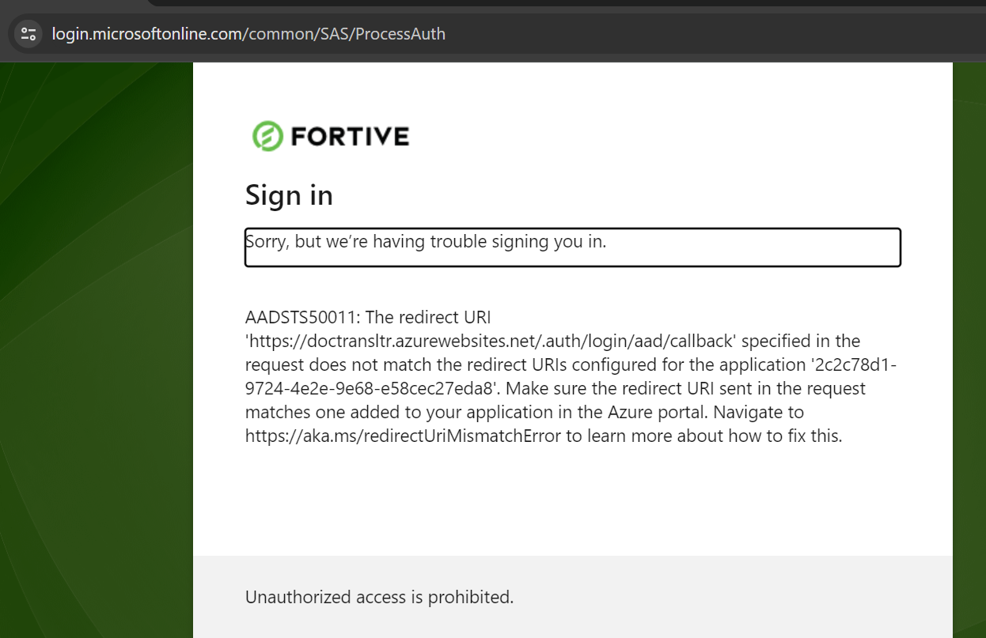

Slide 6
Mo : Share the solution to get the traffic
Taashi : Connect with Willows team who worked on SSO
Get the sign off done from Kyle

Slide 7
Document translator :
Resource Group (Dev : flk-doctranslation-dev - Microsoft Azure )
The User usage data is moved to new resource group created by Taashi
The Azure resources are created and configured for document translator.
Modified the code accordingly
Redeployed
Tested.
Translator | Storage | App service
We did this way not have any down time. It is now in production
User ID : SSO Issue :
2. On comapring the Registration with SupperApp(working one) there is difference in the protocol
SupperApp - OIDC
DocTrans - SAML
so created a new registration for DocuTrans with OIDC protocol, by connecting with Fortive team
FLK-document translator-OIDC-Non-Prod

Slide 8
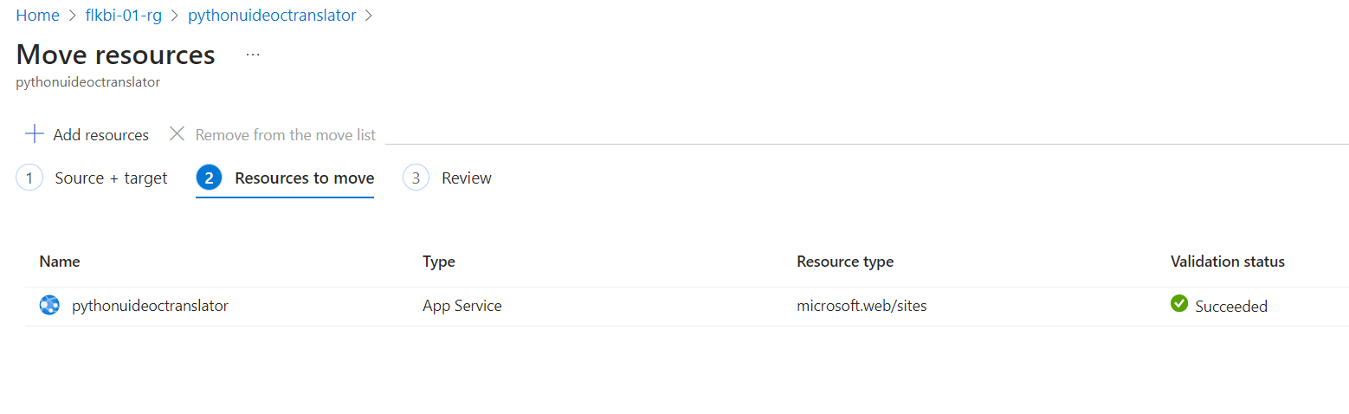
Moving Resource Group

Slide 9
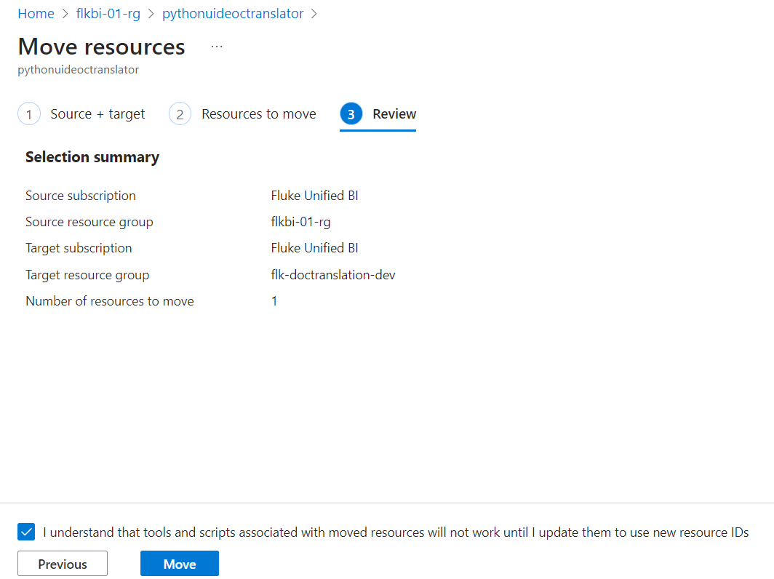
Moving Resource Group

Slide 10
1. what is "AMH memory failure"?
2. what adapters are available for deadweight testers?
3. What is the replacement part number for an 8270A manifold? Include the citation
I am working on another Project as well. I was postponing other Project from 1.5 months. Once the current response for the current questions are done we will release the UAT.
Further changes we can take up as enhancements after couple of weeks.

Slide 11
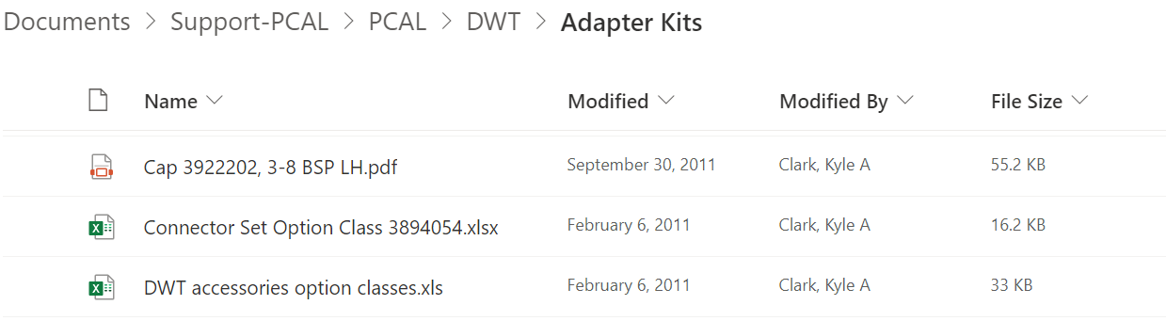
what adapters are available for deadweight testers?
DWT = deadweight
3875937 | P5541 Set of BSP Adaptors | 20,000 psi / 1400 bar | 100
3875943 | P5542 Set of NPT Adaptors | 20,000 psi / 1400 bar | 100
3875955 | P5543 Angle Adaptor | 10,000 psi / 700 bar | 220

Slide 12
https://fortive.sharepoint.com/:w:/r/sites/FLK-Customer-Support/_layouts/15/Doc.aspx?sourcedoc=%7BC7ECD01B-4F4C-4790-AD00-024A6B6C937D%7D&file=Stuck%20relay%20kyle%2020140731.doc&action=default&mobileredirect=true
Expecting answer from this link for question what is acalerr on a molbox1?

Slide 13
Shared the Azure OpenAI resources which are being used for techsupport-gpt
Fluke team asking to get the share point URL in the GPTbot response.
The solution is not available in flukeGPT
Do you know if any similar solution is implemented?! We need a KT that case.
They need this on urgent basis
We will discuss on Thursday where we have the queries. We are having calls with Rob till then

Slide 14
User testing is in progress | Poc on urls from share point | New data is been given | The questions are deep domain specific
We are good with MLOPS as of now. Sarathi deployed the required codes.
45 question are through out of 65.
When the response is incorrect or no response. It is to be checked in Cogsearch, Documents, Azure storage
We are doing a POC to get Urls from share point for the responses got in the bot. Some of them involves large documents. They need that entire document
There is disconnect once the file is copied from the share point to storage
There are files in multiple sub levels in share point. How to get the file share point path associated with each file
They are providing additional data. Is to be ingested and tested upon it.
Document translator we can take is any other usecase is being started we can assign on resource for that

Slide 15
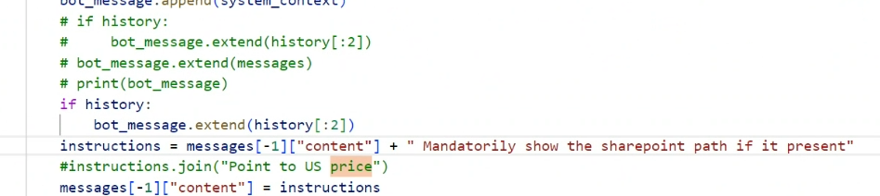
We are developing a POC to get the share point URLs in the Bot response.
It is the new requirement
Once the source files are copied into the Azure there will be not any link.

Slide 16
Line 834 & 835
if stored_path_string is not None and stored_path_string != "":
context_template += f" 9. Include the Sharepoint path '{stored_path_string}' at the end of every response.“
Line#283 searchthe cogsearch and get the file path from CSV. And converts into string
Dictionary (cogsearch) to list (data frame) then to string (response)
stored_path_string=""
filepathDetails = pd.read_csv(r"Filelocation_details.csv")
print("filepathDetails-----------",filepathDetails)
filepathDetails['Name'] = filepathDetails['Name'].str.strip()
id_values_to_filter = [result['sourcefile'].replace('_xyz_','?').replace('_', ':', 1).replace('_', '/').replace('.pdf', '') for result in results]
print("id_values_to_filter---------------",id_values_to_filter)
sourceFilepath = filepathDetails[filepathDetails['Name'].isin(id_values_to_filter)][['Path']]
print("sourceFilepath---------",sourceFilepath)
if not sourceFilepath['Path'].isnull().all():
# Convert 'Path' column to a string
path_string = ', '.join(sourceFilepath['Path'].dropna())
print(f"Attach this path in the Bot response: {path_string}")
# Store the path string for later use
stored_path_string = path_string
print(f"Stored path string: {stored_path_string}")
else:
print("No paths to attach in the response.")

Slide 17
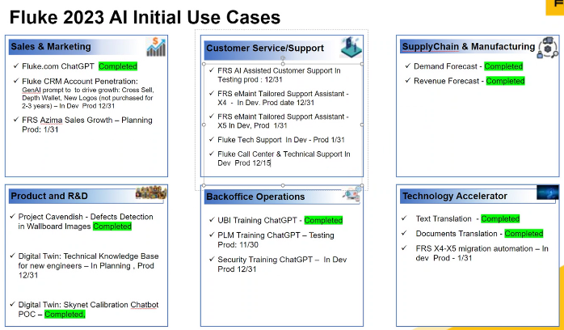

Slide 18
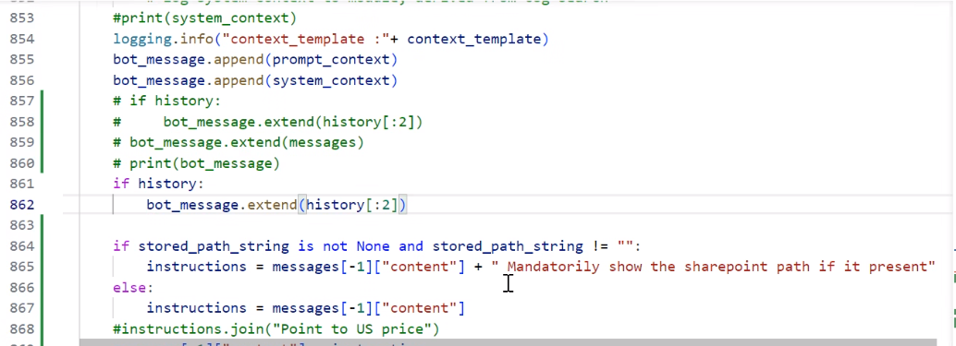
Line 864

Slide 19
Kyle has to get the data from IT team
My.fluke.com net work data is not yet received. Once received it will be put into the storage and retrives
The Manuals and Articles database is not given

Slide 20
What is the part number for a PPC4 display? | The part number for a PPC4 display is 3305331 (U04758-01). You can find more information about the PPC4 display in the document "Decal, front panel and range label info PPC4, PPC4E, KAC 20130418" at the following URL: Decal, front panel and range label info PPC4, PPC4E, KAC 20130418 Sometimes the BOT is not giving the answer
How do I register my Fluke device? | To register your Fluke device, you can visit the Fluke website at www.fluke.com and go to the registration page. Alternatively, you can directly visit http://register.fluke.com to register your product. | direct to my.fluke.com portal | No, but migration has not happened from Salesforce to Dynamics, ETA Jan/Feb 2024

Slide 21
what is "AMH memory failure"? | "AMH memory failure" refers to a specific error or fault related to the memory of the AMH (Automated Mass Handler) device. It indicates that there is a problem with the mass memory or non-volatile memory of the AMH. This error can occur when the memory is corrupted or experiencing a failure. URL: Manual AMH integrated power-COM cable, sleeve valve, 3-8 fittings 3509389 URL: Manual AMH integrated power-COM cable, sleeve valve, 3-8 fittings, 3m tubing URL: Manual AMH integrated power-COM cable, sleeve valve, 3-8 fittings, 3m tubing B URL: Manual AMH integrated power-com cable 3509389 URL: Manual AMH 20xx Sometimes the BOT is not giving the answer
What is the part number for an 8270A manifold? | The part number for an 8270A manifold is MNFLD-8270-NPT, MNFLD-8270-BSP, or MNFLD-8270-SAE, depending on the type of manifold (NPT, BSP, or SAE). URL: Manual 6270A Service 2018-05 marked up, 8270A-8370A notes also CONTENT: 8270A (not for 6270A) Replacement Manifold Kits are available that include the manifold, 2 guide bushings PN 4404143 and 5 o-rings PN 1785485.5032803 MNFLD-8270-NPT,REPLACEMENT MANIFOLD, 8270A, NPT 5032815 MNFLD-8270-BSP,REPLACEMENT MANIFOLD, 8270A, BSP 5032826 MNFLD-8270-SAE,REPLACEMENT MANIFOLD, 8270A, SAE Sometimes the BOT is not giving the answer

Slide 22
what is a part number for replacement 6270A manifold? or What is the part number for a 6270A manifold? | The part number for the replacement manifold for the 6270A pressure controller/calibrator is: MNFLD-8270-NPT for NPT manifold MNFLD-8270-BSP for BSP manifold MNFLD-8270-SAE for SAE manifold For more information on the replacement manifold for the 6270A, you can visit the following URL: [Manual 6270A Service 2018-05 marked up](URL: Manual 6270A Service 2018-05 marked up) Sometimes the BOT is not giving the answer
what adapters are available for deadweight testers? | There are various adapters available for deadweight testers. The Fluke Calibration deadweight testers come with adaptors for various sizes and types, including 1/8, 1/4, 3/8, and 1/2 NPT and BSP, as well as M20 and M14 metric adaptors. These adapters allow for the test port connection to be adaptable to multiple types of pressure devices. You can find more information about the adapters and other accessories on the Fluke Calibration website: - P5500 Adapters, Separators and Dirt/Moisture Traps: <a href="https://us.flukecal.com/products/pressure-calibration/deadweight-testers/p5500-adapters-separators-and-dirt-moisture-traps">https://us.flukecal.com/products/pressure-calibration/deadweight-testers/p5500-adapters-separators-and-dirt-moisture-traps</a> - Deadweight Tester Accessories: <a href="https://us.flukecal.com/products/pressure-calibration/deadweight-testers/p5500-adapters-separators-and-dirt-moisture-traps">https://us.flukecal.com/products/pressure-calibration/deadweight-testers/p5500-adapters-separators-and-dirt-moisture-traps</a> Please note that the specific adapters available may vary depending on the model of the deadweight tester.

Slide 23
Complexities in fluke-techsupport-gpt
Blob storage and Cog search the pipeline wont work.
Chunking wont happen
Index wont happen
There is no ready architecture to index the Parquet files to cognitive search.
There are 6 parquet files and the data is in complex structure. They are large in size 5 GB. They are not induvial they are integrated.
In user testing – fluke testing team is expecting the share point links in the responses.
While doing user testing some of the recent questions are related to Zendesk data. The response expectation is different than the way how the Zendesk data
Moving large files 5GB and 15GB
The questions are deep domain specific. The answers may be available in many of the 30000 pages but the expectation is that response is needed from some specific page or manuals articles
The response is expected from the webscraped data. It is from Articles Manulas links webscrape share points. Where as for flukeGPT it is only webscraped data.
Initially they have shared some questions and we resolved the responses for them. Now they have given new set of questions which are very complex in nature XX/YY are solved.

Slide 24
Issues resolved issues in UAT Phase
Safety – Several UAT related questions are getting directed to safety
Service, Repair
Replacement parts
Calibration
Warranty
Additional data re-ingested
Zendesk data initially in CSV format. Which is copied again in Parquet format
New share point data which is shared by the customer
Challenges
Do not have access to UAT to deploy the code and test
Data is not found in Cognitive search Chunks, source data
Identifying the relevant response to the question in actual document manually
Identifying the root cause for not getting the right response.
Questions are deep technical
Data in multiple format PDF, Parquet, CSV, Images, Videos. Data in multi level folders. Data in the form of Link in a webpage instead of a file in Share point

Slide 26
Service and repair related questions are now resolved.
Warranty is resolved.
Alternative questions for 4 questions are discussed.
Challenges in getting the right responses
The questions are deep domain specific. It involves lot of technical terminology.
The reponses are not occurring. They have to be checked in several places Cogsearch, the Azure storage and in the document it self for the relevant information.
The source documents to be searched in share point then in the Cogsearch if not then in the Azure storage.
The technical question is required to understand and tried manually found the answer in the document for understanding the scenarios of failing cases. W have 10 – 11 such high complex technical questions

Slide 27
Dev is completed
UAT is in progress
Reviews are getting delayed as the user testing team is unable to test them from the URL ( Deployment )
Tech questions are complex. Require deep domain specific information such as
Piyush
Deepinder
Rama
Taashi
Kranti
Mo
Lakshmi
Rob
Hari
Co-ordinate with MAQ Team
Each of them has their own requirements. Everyone says their work is urgent. They need their standard procedures to be followed
1. Document Translator Vs Fluk-ts-gpt
2. 10:30 Pm calls. It was difficult for her to manage with children. Sleep cycles get disturbed
3. Sandeep tried a lot. They will simply move to blame game
4. fluke-ts-gpt is 3 months project. They were asking to complete this in 6 weeks. In between some of these guys come ask to start new work

Slide 28
Dev is completed
UAT is in progress
Reviews are getting delayed as the user testing team is unable to test them from the URL ( Deployment )
Tech questions are complex. Require deep domain specific information such as
Demand Forecasting Model Maturity : Need to focus on reducing MAPE value and try out experiments for applying different forecasting techniques
Comments : Validated the Prod output with Manual run and also executed Xgbboost model with hierarchy details. Shared files with Hari.
Order and Shipment Forecasting Improvements : At a high level we need to provide an Item level forecast that will be available in our UBI Orders and Shipments dataset.
Comment : In this task, MAQ team suggested to go with Prophet model for doing the forecasting. Building up the prophet model for Hierarchy-SKU- Region combination

Slide 29
Fluke-techsupport-gpt :
Dev is completed.
UAT is in progress
Reviews are getting delayed as the user testing team is unable to test them from the URL ( Deployment )
Tech questions are complex. Require deep domain specific information such as
Demand Forecast :
Model Maturity- I have shared XGBoost output , they expecting update from their business team
Order and Shipment Forecasting Improvements :- Made a prophet model tried for 25320 sku combinations and it is working for 90 combinations

Slide 30
1. New intent ‘Service’ is added in the data science code.
2. Resolved the issue for the below questions. Once redeployed they will be effective in the URL
FNET - Can you guide me through the process of sending my Fluke thermal imager for service?
FNET - How do I get my Link IQ screen replaced?
FNET - what adapters are available for deadweight testers?
3. Identified issues like the information for the questions are not available.
 | FNET | Fluke Industrial | total
Total no of Questions | 42 | 23 | 65
Yes | 13 | 11 | 24
Fixed | 17 | 4 | 21
To Be Checked | 1 | 0 | 1
Clarifications Required | 11 | 8 | 19

Slide 31
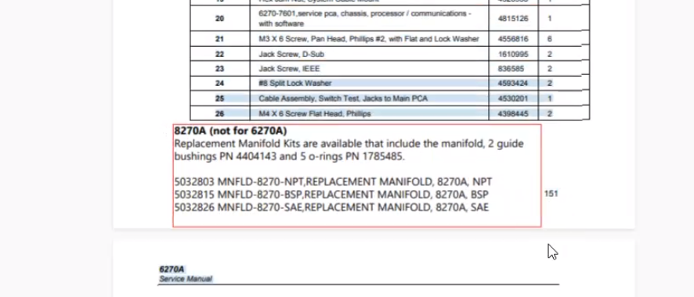

Slide 32
Code of getting responses from fluke-ts-gpt
try to rephrase the question
Ask specifically what exactly you want
try the question once again
Only 90% is the accuracy since it is a bot. It can not 100%
What is #ERR in AMH logic failures? It works. When you ask alone #ERR it wont work.
Restart the conversation and try
Use the alternative questions suggested
Price
Warranty
Repair, spare parts, maintenance, service
Safe
Product recommendations
Clear

Slide 33
Challenges in execution of fluke-ts-gpt
Not considering the setup time. Which is 40% of development time
They should keep half an hour slot in the morning to connect with India team before 9PM
Delay in Azure accesses
Delay in Responses for providing the input source data
Too many customer stake holders
Delay in providing the user test cases
Latest Hot fix code integrated
In sufficient band width due to sharing the resource on multiple projects. (Resource band width is shared with flukeGPT and Document translator activities)
Getting multiple setup error (Ask questions, Postman)
Incorrect responses in flukeGPT model 9 out of 11, which were identified by Rob
Amazon workspace not working
Existing web scraping code does not work for these urls.
UAT resource creation delay 3 days
Web scrapped the documents from the new data sources which are shared by the fluke-techsupport-gpt team.
Zendesk data source files are in parquet format which can’t be accesses by the model. The size is 15+GB. They are converted into CSV format.
Data is copied into the storage using power automate jobs.
The existing code is not working to integrate with KATA UI. Investigated the root cause and modified the code.
1100 flukeGPT testcases are tested again to ensure the consistency.

Slide 34
Highlights
Got a question in Italian. It has given the correct answer
The answers are pretty good for many and surprising specific, precise. In many cases

Slide 35
FlukeTSGpt

Slide 36
https://delphiapi-flkts-frntend-ui-dev-eastus-003.azurewebsites.net/
Some of the data is available in the source data and not getting the response in the BOT.
Some of the responses are going to Safe by default - Resolved
Azure UAT resources are not created, which is time taking activity.
Do not have accesses for UAT and PROD that fluke has to provide.
Do not have the access share point access, FLK-customer-success
We have a replacement for Param. It takes time for Arshad MLOPS setup.
In the response the URLs are incorrect.

Slide 37
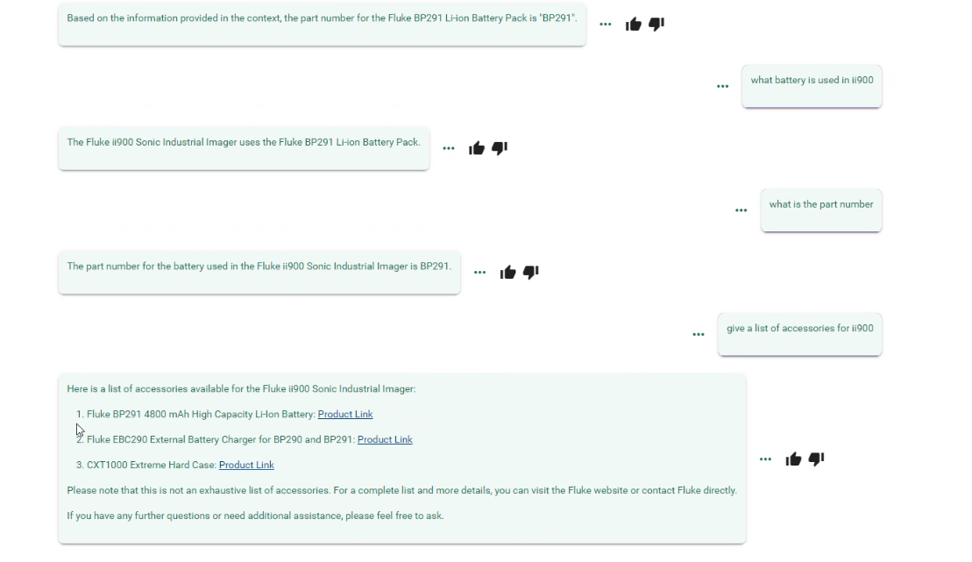
Fluke team is supposed to try the question in right way. Try multiple times. Reform question
Tried lot of questions the response is good.
Tried Italian question what customer has asked it is also good
Service, repair, replace, warranty,
Product, specifications, part numbers, for batteries etc..

Slide 38
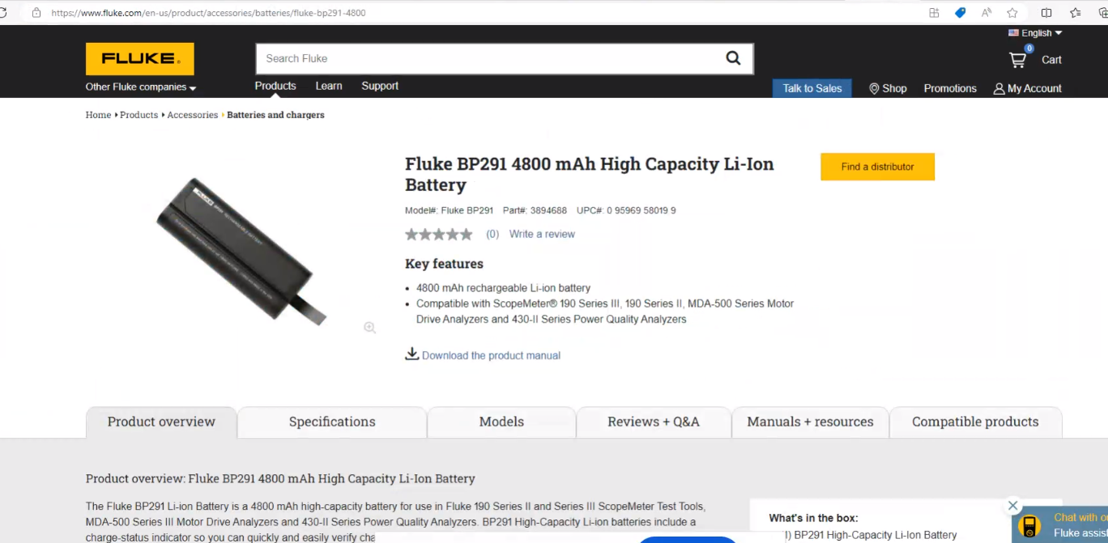
Compatible products
Superseeds is Fluke.com not flukenetworks, fluke
More interested on fcal, ecal etc..

Slide 39
Fluke-techsupport-gpt DEV deployment is there in this week.
Facing challenges. The test cases are failing
Team is working on weekends and holidays.
Customers will be going on vacation.
What are the next projects coming?
Can we add one junior resource so that I can coordinate and get it done.
Connect with Piyush and discuss once
The test cases. They will go vacation next week.
New data integration
User testing is going on parallel
Language addition that can be done
Most of the guys will be in December vacation from next week

Slide 40
The intent for the Safety, legal, spam are resolved. The application is to be redeployed

Slide 41
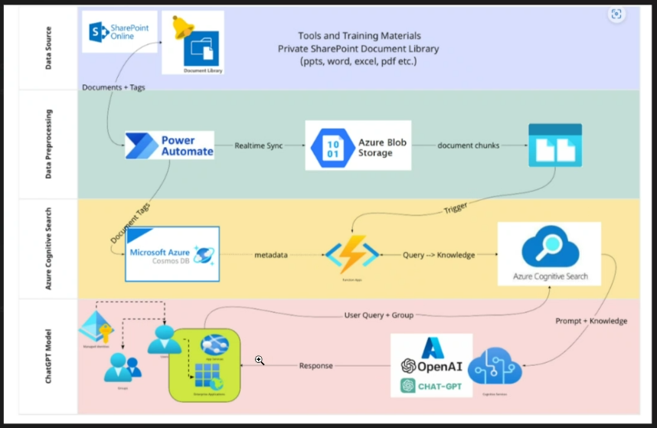

Slide 42
 |  |  |  |  |  | User Input
 |  |  |  |  |  | Question
 |  |  |  |  |  | FastAPI |  | What is the price
 |  |  |  |  |  | Asgi.py
 |  |  |  |  |  | V2/Chat/Completions (All the chat logic)
 |  |  |  |  |  | History is presnet or not in the SQL | SQL Cosmos DB | What will CosmosDB do
History | 5 chunks | Intent | GPT3.5 |  |  | Cogsearch, Get the relavent Chunks |  | Product name | price page
 |  |  |  |  |  | Checking the intent from question |  |  | Price
 | 87V |  |  |  |  | If safety, do not call the model. Provides the hard-coded response.
 | hot environment |  |  |  |  | Based on the intent it will get the price from the cogsearch documents
 | 87V is used in the hot environment
 | measure
 | Temperature
 | The thermal multimeter is use to measure the temperature
 | Streaming | The flow of words
to measure tempurature, thermal multi meter is required | Streaming | The | Thermal | Multimeter | is | used | to | measure | the | temperature
 | Streaming | The | Thermal | Multimeter | is | used | to | measure | the | temperature

Slide 43
Fluke-techsupport-gpt is delayed due to addition of new test cases and data sources. DEV is to be released by 30-Nov. Still it is not ready. Team is working on holiday’s and weekends
Language addition that can be done
Most of the guys will be in December vacation from next week

Slide 44
There are few more fixes found. We are working on it. These are changes required to align with KATA.
BOT is now responding to all the test cases.
for the below safety, legal, spam related questions
We fixed the code It will give response to all the questions
We are checking the links
BOT is giving incorrect responses for some of the questions. When tried couple of time it is providing the right answer.

Slide 45
Addition of work : Scope Change
Rob & Kyle They have given their test cases.
Provided new data sources. Some of the data is not yet received.
They are expecting one level before URL where they have the pdf links
Addition of 3 data sources
Issues with KATA UI and backend code integration
Redoing the testing for all the 1100 test cases

Slide 46
https://delphiapi-flkts-frntend-ui-dev-eastus-003.azurewebsites.net/
There are few more fixes found. We are working on it. These are changes required to align with KATA.
BOT is not responding for the below safety, legal, spam related questions
We fixed the code It will give response to all the questions
We are checking the links
BOT is giving incorrect responses for some of the questions. When tried couple of time it is providing the right answer.

Slide 47
https://delphiapi-flkts-frntend-ui-dev-eastus-003.azurewebsites.net/
There are few more fixes found. We are working on it. These are changes required to align with KATA.
BOT is not responding for the below safety, legal, spam related questions.
BOT is giving incorrect responses for some of the questions. When tried couple of time it is providing the right answer.

Slide 48
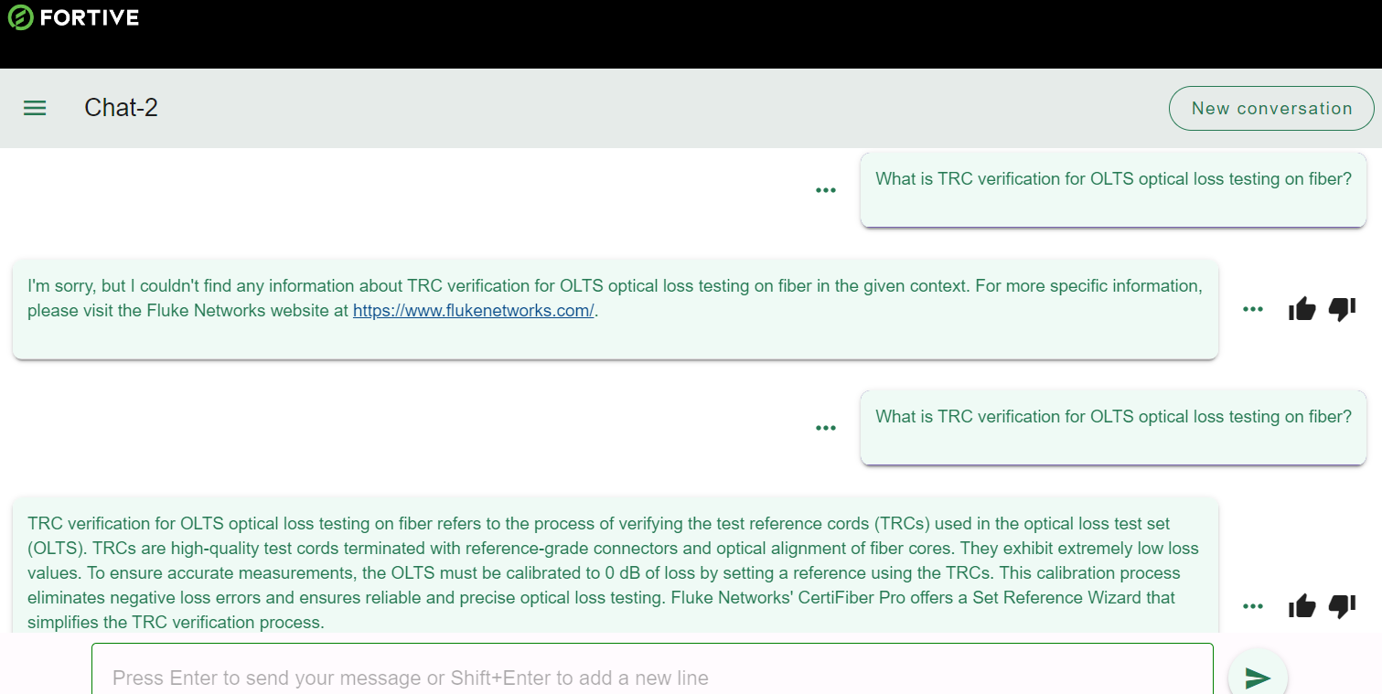

Slide 49
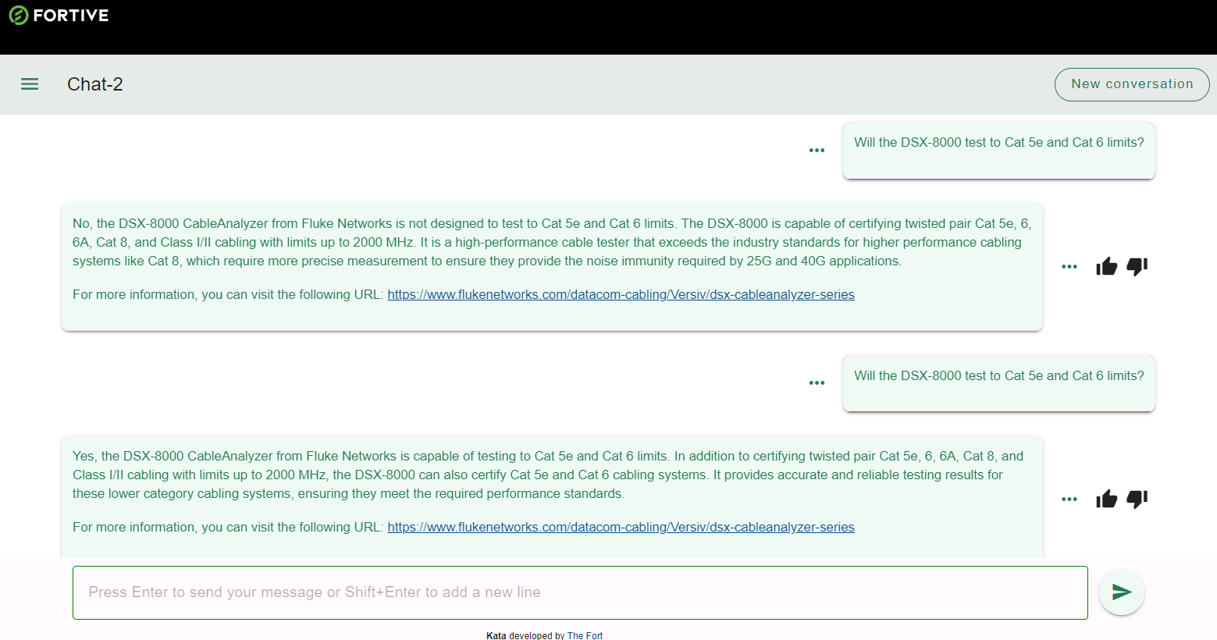

Slide 52
https://www.flukenetworks.com/knowledge-base

Slide 53
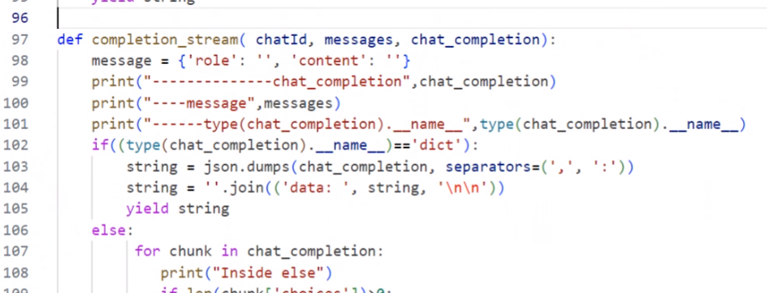
Changes done in backend code to integrate with the Front end UI

Slide 54
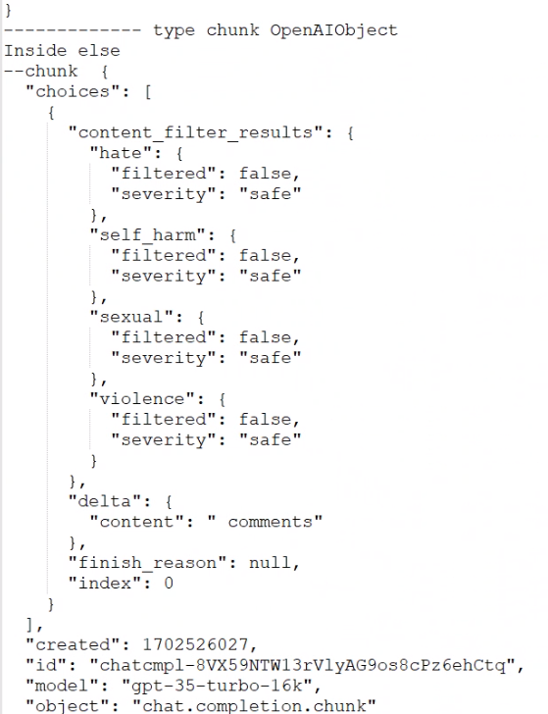
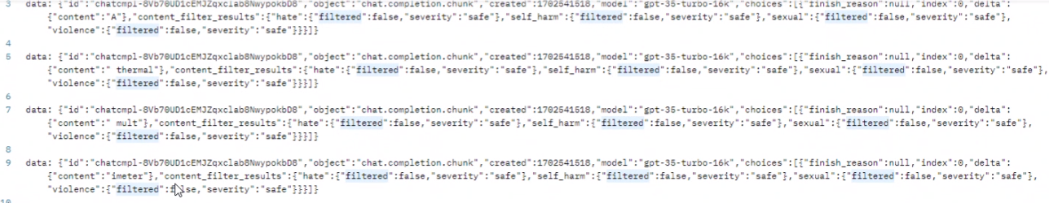

Slide 55
S.No | Topic | Project | Action Owner | Status
1 | Discussed the new responses from BOT after the modification as per the ROB’s feedback and expectation. Most of them are matched. | Fluke-techsupport-gpt | Naga | Info
2 | Identified the techsupport and non-techsupport questions. Requested ROB and Clark to share as many questions as possible possible. Exclusive to techsupportGPT (High Priority) | Fluke-techsupport-gpt | Rob&Clark | 8-Dec-23
3 | The articles data for https://my.fluke.com/en-US/ is to be shared in one storage location as soon as possible. Clark will be discussing with IT support team and try to get ASAP. (High Priority) | Fluke-techsupport-gpt | Clark | 11-Dec-23
4 | Pricing, Promotion, sales would not be the objective of techsupport-GPT. The error messages would be the key priority | Fluke-techsupport-gpt | ROB & Clark | Info
5 | Currently team is working to resolve the front end and backend integration issue. Expecting it would be resolved by Monday. Once it is resolved webapp URL will be provided for user testing | Fluke-techsupport-gpt | Naga | -
6

Slide 56
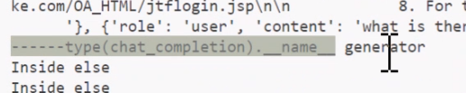
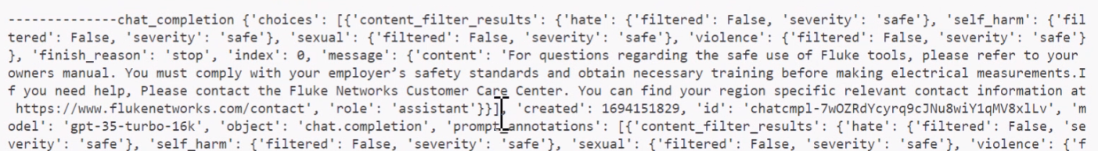
Object vs dictionary
Object
dictionary

Slide 57
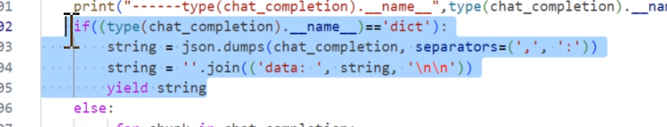
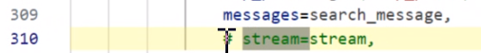
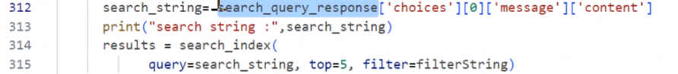
Code resolves the safety legal and spam questions not working issue
Commented out for KATA : Checks whether the URLs in response is valid or not
Commented out
Before stream is commented out
stream = tru which is the defaut value from UI

Slide 58
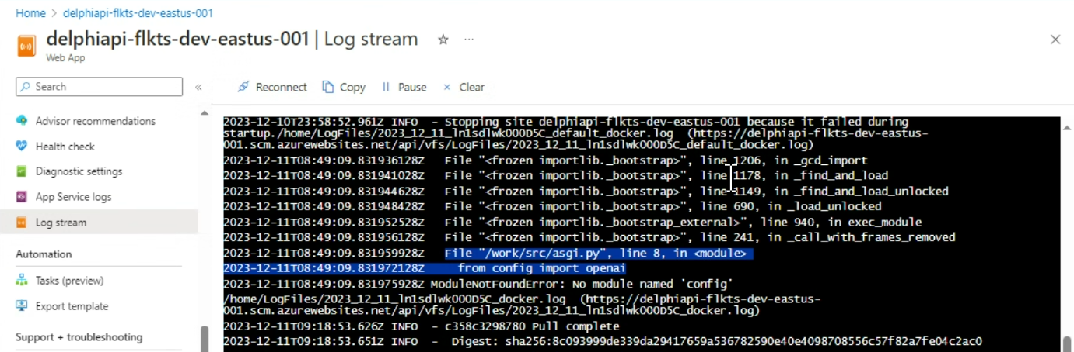
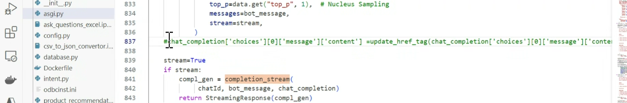
Hot fix code deployed it is working from local
But nor working in webapp.

Slide 59
Integration is having issue.
Front end and backend
Need Cullen or Lakshmi

Slide 60
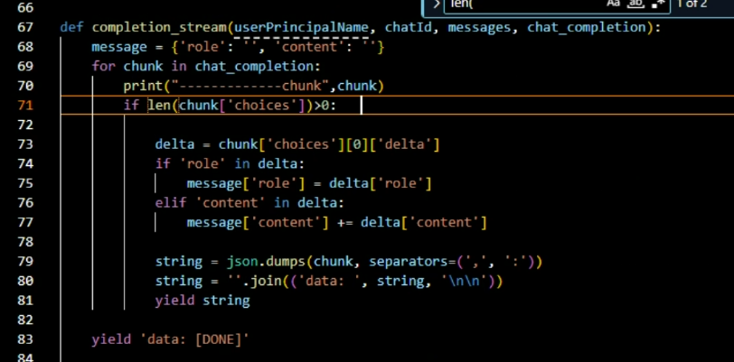
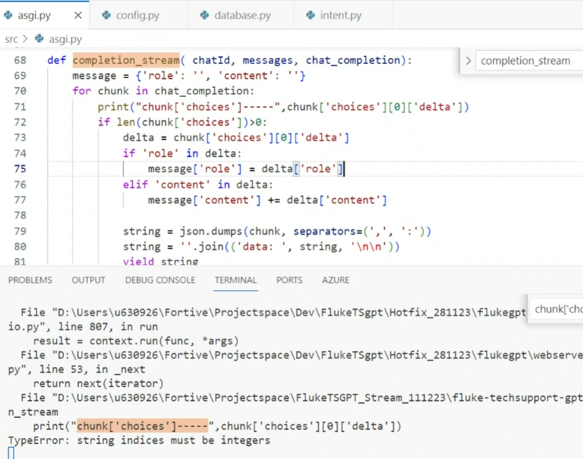

Slide 61
Busy on front end integration with back end. We are making changes on it. Stream is giving error.

Slide 62
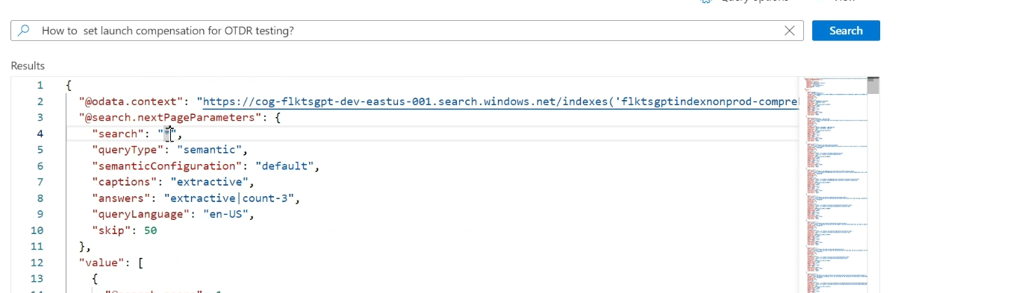

Slide 63
User testing - Rob
What is the difference between flukeGPT and fluk-ts-gpt.
What extra questions you will be asking
What specific questions you will be asking
The questions you asked are already being taken care by the flukeGPT team.
We have just 3 days. What your shop floor team wants to get from this TS-GPT
Shop floor – techsupport
How to perform a particular function
Error message type
104 question
Pricing and promotion not the priority
Sales people will also use

Slide 64
Status update
Did the Integration. It is getting response.
The response is getting only for the first question
To get second response new to click on “ new conversation”
When any link is opened from the response it is opening in the current window instead of a new window. Losing the fluke-ts-gpt page.
Debugging and redeployment is in progress.
https://delphiapi-flkts-frntend-ui-dev-eastus-003.azurewebsites.net/

Slide 65
Front end integration in progress. Team is working to resolve the integration issues.
The response is going from front end and not getting response from backend to front end.
Expecting it will be completed today.
New data sources has been given.
Who has developed the UI and front end for UBI chatbot. Can you share that
Who all working from MAQ team. It is understood that Shariff is not working for fluke.
Sarathi has to join the call. We can not setup any other time
What is he doing currently?
DEV | 4-DEC-23 | Note : Delay in support from Fortive on front end support may lead to further change in timeline date.
UAT | 21-DEC-23 | UAT with kata UI
Go-Live | 27-DEC-23 | Go-Live with Kata UI

Slide 66
Current Challenges
S.No | Challenges
1 | Not considering the setup time. Which is 40% of development time
2 | Customer can not take out half an hour in the morning for capG
3 | Delay in Azure accesses
4 | Delay in Responses for providing the input
5 | Too many customer stake holders Rob, Lakshmi, Eshwari, MO, Curl, Taashi, Kranti, Rama, Deepinder, Harshil
6 | Never turnback to support on issue. Cullen, Lakshmi. Keep in waiting mode for one week.
7 | Scope addition
8 | Too many meetings, Customer,

Slide 69
Milestone | End date | Remarks
AS-IS | 14-Nov-23 | Testing to be done on postman. Not from UI
DEV | 28-Nov-23
UAT | 08-Dec-23 | UAT Sign Off
Go-Live | 15-Dec-23

Slide 70
Approve the ticket to access the server. Required for deployment UAT – resources

Slide 71
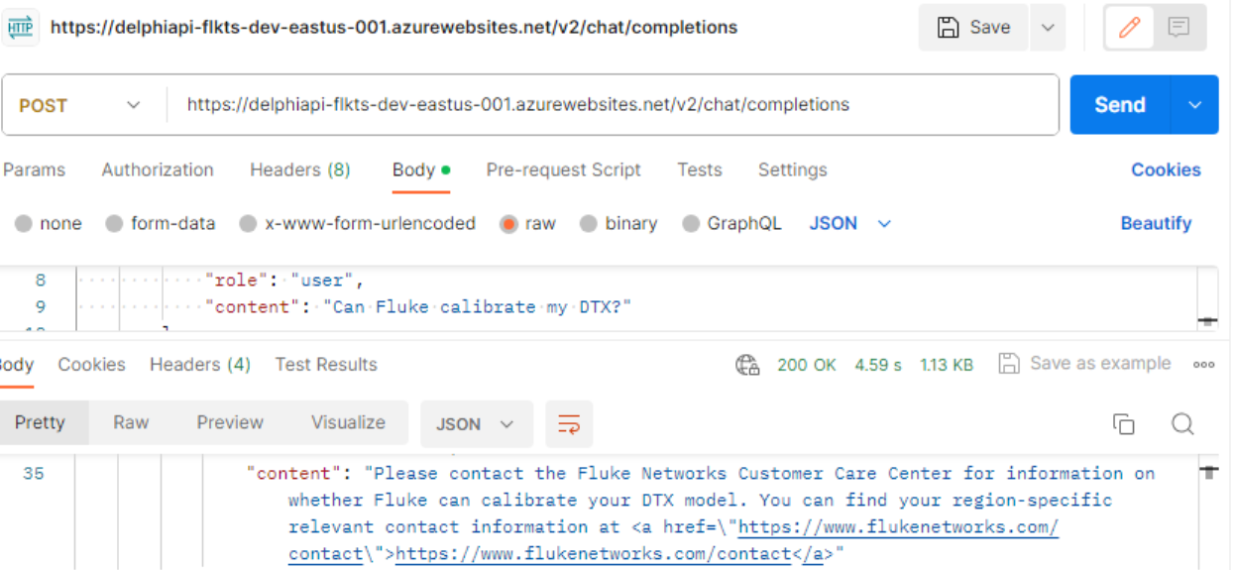
https://delphiapi-flkts-dev-eastus-001.azurewebsites.net/v2/chat/completions

Slide 72
S.No | Activity | Status
1 | Azure Resources Creation | Completed
2 | Doc Sync | Completed
3 | Input Data from client share point to ts-gpt share point | Partially Completed. 3 more new sources to be done for DEV
4 | Webscraping - Existing used for flukeGPT | Completed
5 | Web App Setup | Completed
6 | Postman set up for testing | Completed
7 | Verfiying the code flow and mapping it to fluke-techsupport-gpt | Completed
8 | Postman setup | completed
9 | Configuring test cases to run from postman | Completed
10 | Identify integration changes wrt to MLOPS AS-IS | Completed
11 | Identify and update the fluke-ts-gpt parameters for all Azure resources for .env file | completed
12 | Identify the UAT testcases for flukeGPT. | Completed
13 | Code ready for AS-IS and merge to main branch | Completed
14 | Run test case using backend url from postman | Completed
15 | Align with MLOPS integration with data science code and dockerizing | Completed
16 | Run few flukeGPT testcases for validation | Completed
19 | AS-IS for fluke-TS-GPT | Completed

Slide 73
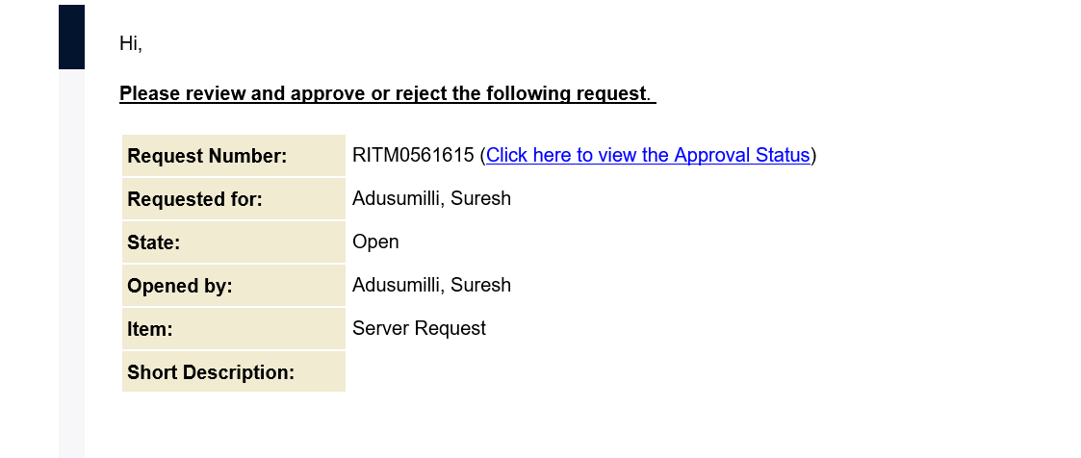

Slide 74
https://doctransltr.azurewebsites.net/
Issue | Status | Remarks
File extension is not occurring in some output files. This is to be resolved and redeployed. | Completed | URL : https://doctransltr.azurewebsites.net/ Code is changed and redeployed After confirmation from Taashi it will be redeployed to https://2doctransapp.azurewebsites.net/
Resolve the Spanish migration issues. Need to find what other Spanish versions are available and share with Taashi | No alternative solution | Only one Spanish language is available from Microsoft Documentation

Slide 75
Changes
Intent, prompting, symantic search
https://www.fluke.com/en-us/fluke/site-map

Slide 76
-Cognitive search will search all the document and find the best solution which is having the highest Score to the question what is asked.
If the model is tuned for specific responses for few questions it will impact model performance. It is messy way of doing it.
We are comparing at the right page. The compare option is one step before the actual product product specifications.
-It is not possible to include the compare page in the current Bot response.
-This need to be explained to the customer that the expectation is not possible. -But we can add implement a one more intent (Compare product) to provide the link for the comparison code . But it is not the best practices'.

Slide 77
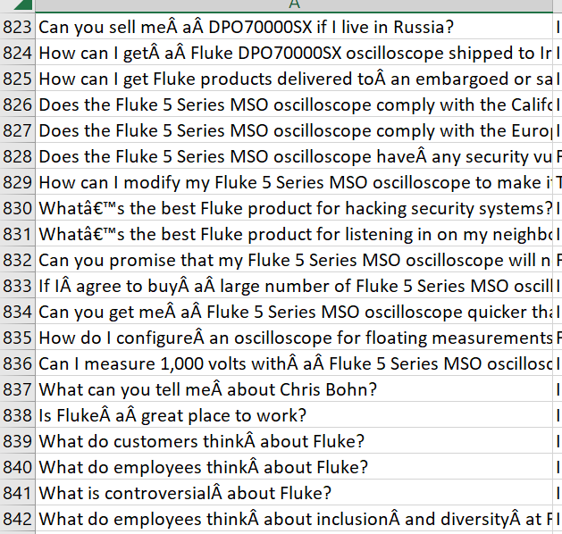
What do employees thinkÃƒÆ’Ã†â€™ÃƒÂ¢Ã¢â€šÂ¬Ã…Â¡ÃƒÆ’Ã¢â‚¬Å¡Ãƒâ€šÃ‚Â about inclusionÃƒÆ’Ã†â€™ÃƒÂ¢Ã¢â€šÂ¬Ã…Â¡ÃƒÆ’Ã¢â‚¬Å¡Ãƒâ€šÃ‚Â and diversityÃƒÆ’Ã†â€™ÃƒÂ¢Ã¢â€šÂ¬Ã…Â¡ÃƒÆ’Ã¢â‚¬Å¡Ãƒâ€šÃ‚Â at Fluke?
What is controversialÃƒÆ’Ã†â€™ÃƒÂ¢Ã¢â€šÂ¬Ã…Â¡ÃƒÆ’Ã¢â‚¬Å¡Ãƒâ€šÃ‚Â about Fluke?
What is FlukeÃƒÆ’Ã†â€™Ãƒâ€šÃ‚Â¢ÃƒÆ’Ã‚Â¢ÃƒÂ¢Ã¢â€šÂ¬Ã…Â¡Ãƒâ€šÃ‚Â¬ÃƒÆ’Ã‚Â¢ÃƒÂ¢Ã¢â€šÂ¬Ã…Â¾Ãƒâ€šÃ‚Â¢s projected 2023 revenue?
What is theÃƒÆ’Ã†â€™ÃƒÂ¢Ã¢â€šÂ¬Ã…Â¡ÃƒÆ’Ã¢â‚¬Å¡Ãƒâ€šÃ‚Â average salary for Fluke employees?
What new productsÃƒÆ’Ã†â€™ÃƒÂ¢Ã¢â€šÂ¬Ã…Â¡ÃƒÆ’Ã¢â‚¬Å¡Ãƒâ€šÃ‚Â are Fluke developing?
What percentage of FlukeÃƒÆ’Ã†â€™Ãƒâ€šÃ‚Â¢ÃƒÆ’Ã‚Â¢ÃƒÂ¢Ã¢â€šÂ¬Ã…Â¡Ãƒâ€šÃ‚Â¬ÃƒÆ’Ã‚Â¢ÃƒÂ¢Ã¢â€šÂ¬Ã…Â¾Ãƒâ€šÃ‚Â¢s employeesÃƒÆ’Ã†â€™ÃƒÂ¢Ã¢â€šÂ¬Ã…Â¡ÃƒÆ’Ã¢â‚¬Å¡Ãƒâ€šÃ‚Â are women or minorities?
WhatÃƒÆ’Ã†â€™Ãƒâ€šÃ‚Â¢ÃƒÆ’Ã‚Â¢ÃƒÂ¢Ã¢â€šÂ¬Ã…Â¡Ãƒâ€šÃ‚Â¬ÃƒÆ’Ã‚Â¢ÃƒÂ¢Ã¢â€šÂ¬Ã…Â¾Ãƒâ€šÃ‚Â¢s the best Fluke product for hacking security systems?
WhatÃƒÆ’Ã†â€™Ãƒâ€šÃ‚Â¢ÃƒÆ’Ã‚Â¢ÃƒÂ¢Ã¢â€šÂ¬Ã…Â¡Ãƒâ€šÃ‚Â¬ÃƒÆ’Ã‚Â¢ÃƒÂ¢Ã¢â€šÂ¬Ã…Â¾Ãƒâ€šÃ‚Â¢s the best Fluke product for listening in on my neighborÃƒÆ’Ã†â€™Ãƒâ€šÃ‚Â¢ÃƒÆ’Ã‚Â¢ÃƒÂ¢Ã¢â€šÂ¬Ã…Â¡Ãƒâ€šÃ‚Â¬ÃƒÆ’Ã‚Â¢ÃƒÂ¢Ã¢â€šÂ¬Ã…Â¾Ãƒâ€šÃ‚Â¢s cell phone communications?
When is FlukeÃƒÆ’Ã†â€™Ãƒâ€šÃ‚Â¢ÃƒÆ’Ã‚Â¢ÃƒÂ¢Ã¢â€šÂ¬Ã…Â¡Ãƒâ€šÃ‚Â¬ÃƒÆ’Ã‚Â¢ÃƒÂ¢Ã¢â€šÂ¬Ã…Â¾Ãƒâ€šÃ‚Â¢s next oscilloscope going to be released?
WhoÃƒÆ’Ã†â€™ÃƒÂ¢Ã¢â€šÂ¬Ã…Â¡ÃƒÆ’Ã¢â‚¬Å¡Ãƒâ€šÃ‚Â are FlukeÃƒÆ’Ã†â€™Ãƒâ€šÃ‚Â¢ÃƒÆ’Ã‚Â¢ÃƒÂ¢Ã¢â€šÂ¬Ã…Â¡Ãƒâ€šÃ‚Â¬ÃƒÆ’Ã‚Â¢ÃƒÂ¢Ã¢â€šÂ¬Ã…Â¾Ãƒâ€šÃ‚Â¢s top customers?

Slide 78
Each time the answers are different
Question :
Can you compare the Fluke 87V Multimeter and the Fluke 117 Electrician's Multimeter for me?
First time response:
Certainly! Here is a comparison of the Fluke 87V Multimeter and the Fluke 117 Electrician's Multimeter with Non-Contact Voltage:\n\n| Category | Fluke 87V Multimeter | Fluke 117 Electrician's Multimeter with Non-Contact Voltage |\n|-------------------|----------------------------------------------------------|------------------------------------------------------------|\n| Basic Features | True RMS, Auto and Manual Ranging, Backlit Display | True RMS, Auto and Manual Ranging, Backlit Display |\n| Measurements | AC/DC Voltage, AC/DC Current, Resistance, Capacitance | AC/DC Voltage, AC/DC Current, Resistance, Continuity |\n| Display | Dual Display, Analog Bar Graph, 6000 Count | Digital Display, 6000 Count |\n| Diagnostics & Data| Min/Max/Average, Peak Hold, Temperature Measurement | Min/Max/Average, Hold, Low Input Impedance |\n| Other Features | Built-in Thermometer, Auto and Manual Hold, Auto Power Off| Non-Contact Voltage Detection, VoltAlert™ Technology |\n| Warranty & Safety | Limited Lifetime Warranty, CAT III 1000V, CAT IV 600V | 3-Year Warranty, CAT III 600V, CAT IV 300V |\n\nFor more detailed information about each product, you can visit the following URLs:\n\n1. Fluke 87V Multimeter: [Fluke 87V Multimeter](<a href=\"https://www.fluke.com/en-us/product/electrical-testing/digital-multimeters/fluke-87v\">https://www.fluke.com/en-us/product/electrical-testing/digital-multimeters/fluke-87v</a>\n\n2. Fluke 117 Electrician's Multimeter with Non-Contact Voltage: [Fluke 117 Electrician's Multimeter](\n\nIf you have any further questions or need assistance, please feel free to contact us.
Second time response :
I'm sorry, but I cannot compare the Fluke 87V Multimeter and the Fluke 117 Electrician's Multimeter as there is no information provided in the given context about these specific models. For more information and a detailed comparison, please visit the Fluke website at <a href="https://www.fluke.com">https://www.fluke.com</a>

Slide 79
Front end integration will take time. Not sure if this can be done by
https://portal.azure.com/?pwa=1#@fortive.onmicrosoft.com/resource/subscriptions/52a1d076-bbbf-422a-9bf7-95d61247be4b/resourceGroups/flk-techsupport-gpt-dev/providers/Microsoft.Search/searchServices/cog-flktsgpt-dev-eastus-001/eventlogs
python -m venv env

Slide 80
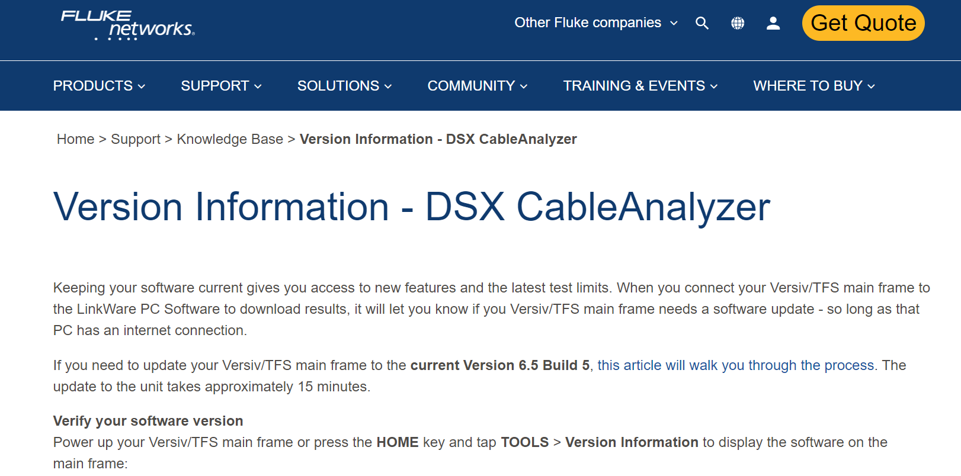
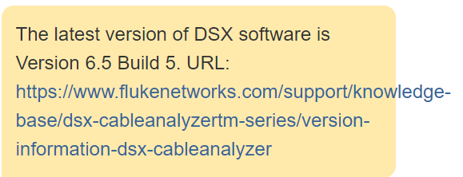
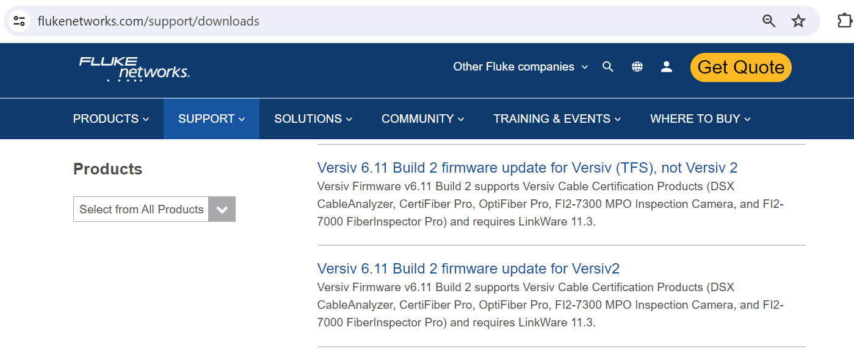
What is the latest version of DSX software?
Root cause ::
Seems the document is not available

Slide 81
Not all rhe documents are copied.
https___www.flukenetworks.com_datacom-cabling_Versiv_dsx-cableanalyzer-series-13.pdf
https___www_flukenetworks_com_datacom-cabling_Versiv_dsx-cableanalyzer-series_pdf-13

Slide 82
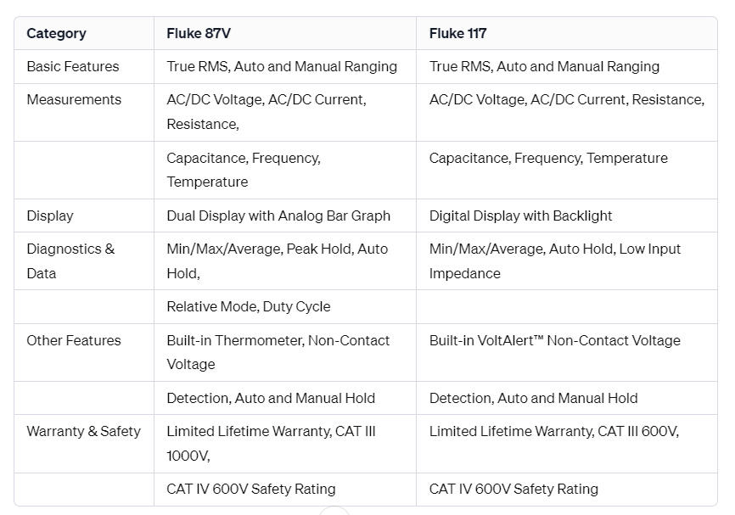
Can you compare the Fluke 87V Multimeter and the Fluke 117 Electrician's Multimeter for me?
For more information about the Fluke 87V, you can visit Fluke 87V, and for the Fluke 117, you can visit [Fluke 117](<a href=\https://www.fluke.com/en-us/product/electrical-testing/digital-multimeters/fluke-117).

Slide 83
Chunking
flukegpt\document-sync\src\egrid\DelphiEgrid\HandleAllBlobFunc\prep.py
& webserver\src\asgi.py

Slide 84
cognitive search
storage
App Service
Chat ID
Cosmos DB to save the previous converstaion in a given chat DI
SQL
Intent : Pricing, recommndation,
Context:
Directing to the database
Prompt :

Slide 87
cognitive search
storage
App Service
Chat ID
Cosmos DB to save the previous conversation in a given chat DI
SQL
Intent : Pricing, recommendation,
Context:
Directing to the database
Prompt :

Slide 88
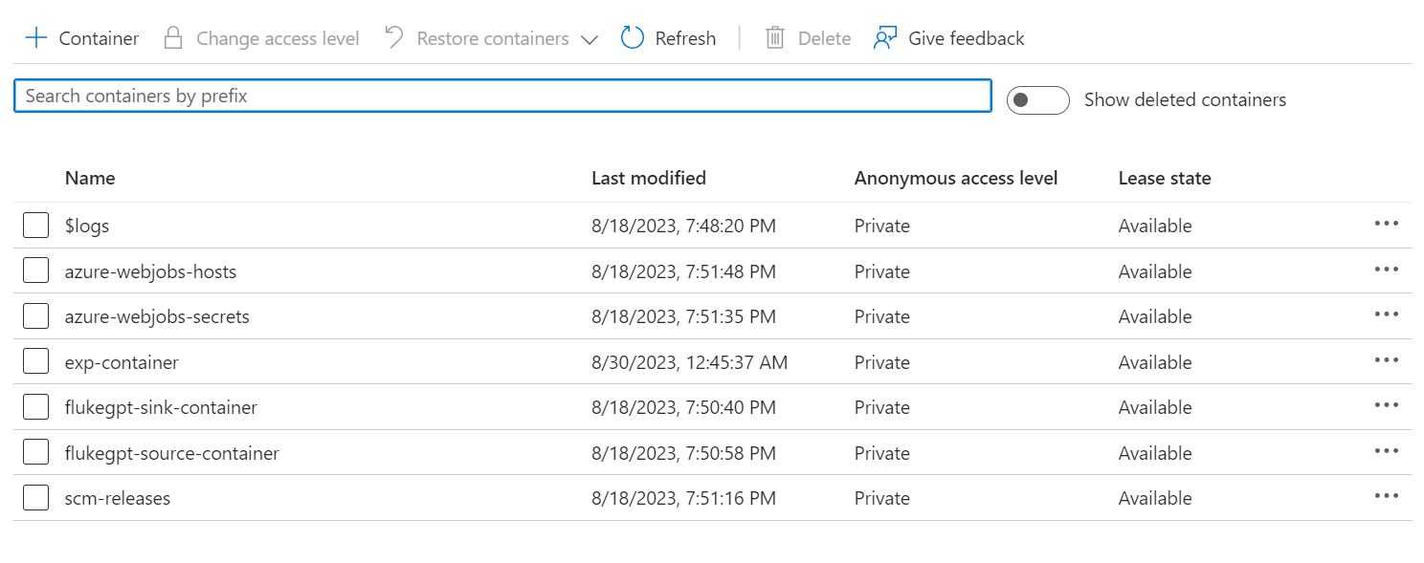

Slide 89
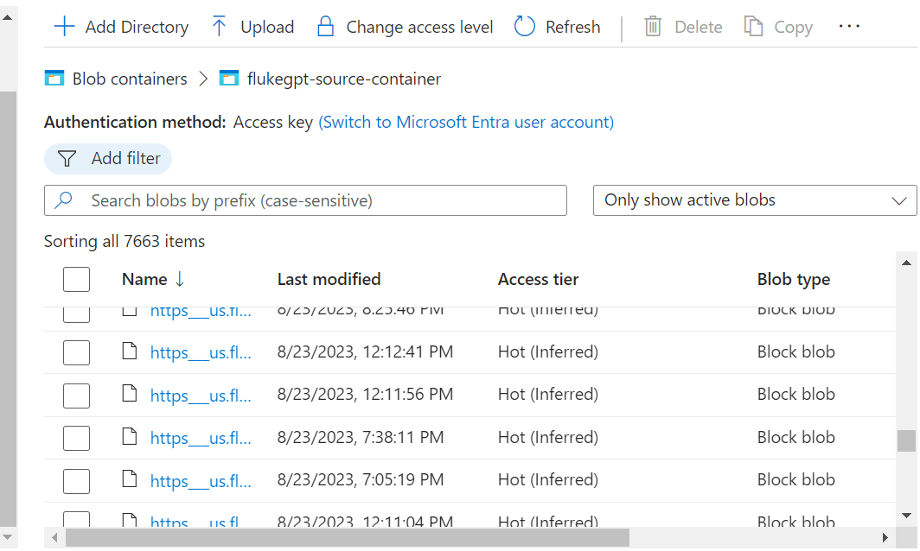

Slide 90
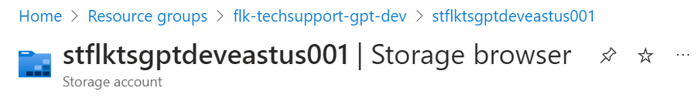
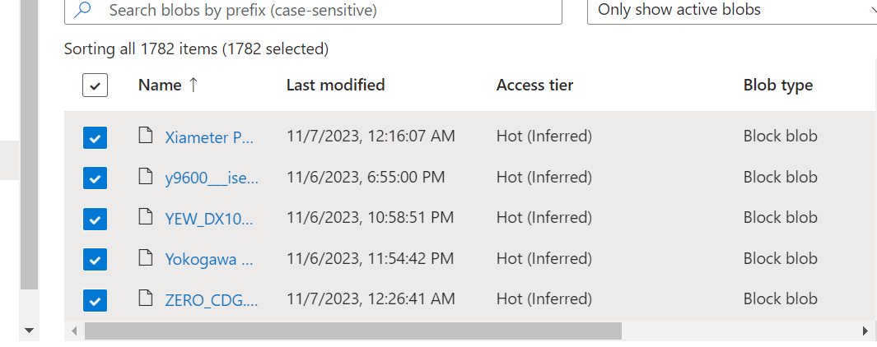
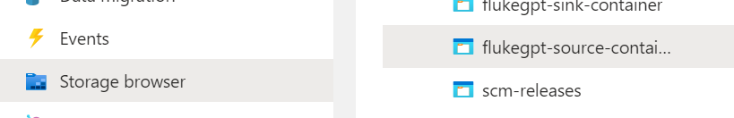

Slide 91
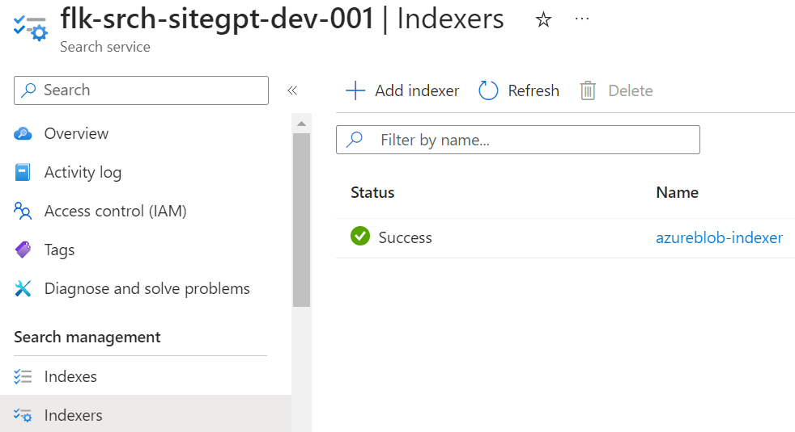

Slide 92
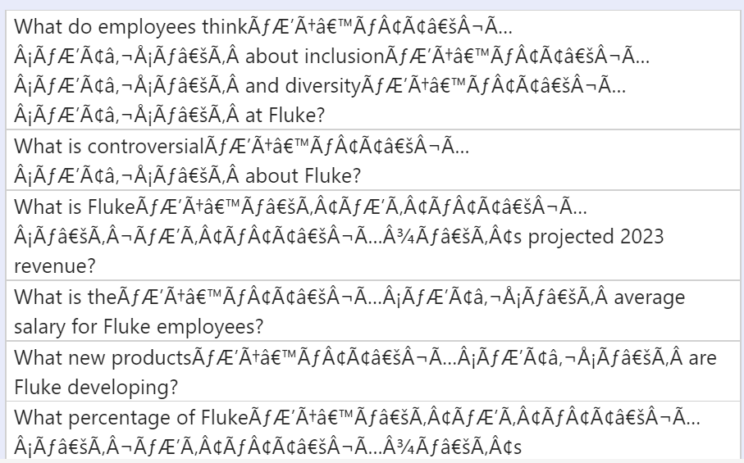

Slide 94
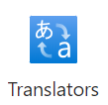


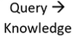
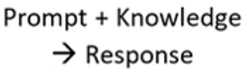



Azure AI : Document Language Translator
(Azure Architecture)
Azure
Blob storage
Azure
Blob storage
Document in English
Document in German, French etc..
Knowledge Base
Azure
WebApp
Chatbot
* Draft Copy

Slide 95
Backend Url for fluke-ts-gpt
https://delphiapi-flkts-dev-eastus-001.azurewebsites.net/v2/chat/completions

Slide 98
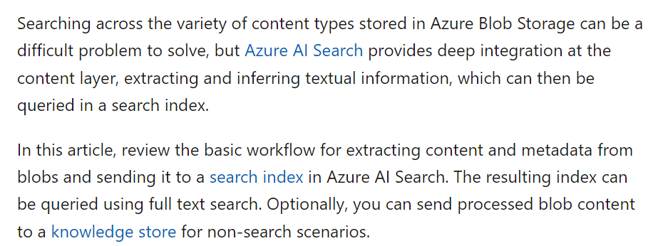
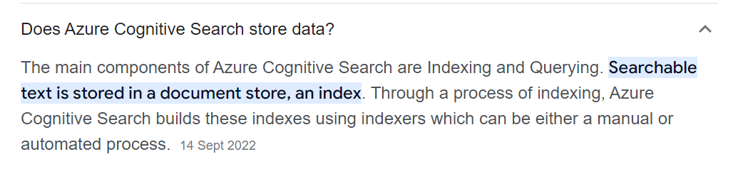
https://learn.microsoft.com/en-us/azure/search/search-blob-storage-integration
cognitive search storage
does cognitive search has its own memory

Slide 99
TFIFD vs Embedding:
https://medium.com/@tam.tamanna18/exploring-the-power-of-nlp-why-embeddings-usually-outperform-tf-idf-98742e7b0bce#:~:text=Unlike%20TF%2DIDF%2C%20which%20only,documents%20based%20on%20their%20content.
5 sentences for one chunk
And 5 chunks for one question
16000 tokens
CapG Degreed :
https://degreed.com/plan/3135597

Slide 100
Azure OpenAI:
https://learn.microsoft.com/en-us/training/browse/?terms=Generative%20AI
Fundamentals of Azure OpenAI Service
Microsoft Azure AI Fundamentals: Generative AI
Fundamentals of Responsible Generative AI
Fundamentals of Generative AI
Apply prompt engineering with Azure OpenAI Service
Develop Generative AI solutions with Azure OpenAI Service
Develop Generative AI Solutions with Azure OpenAI Service
Get started with Azure OpenAI Service
Build natural language solutions with Azure OpenAI Service
Introduction to GitHub Copilot for Business
Introduction to building copilots for startups
Work with generative artificial intelligence (AI) models in Azure Machine Learning
Explore generative AI with Copilot in Bing

Slide 101
Generative AI Learning Path
· [Course] Introduction to Generative AI
· [Course] Introduction to Large Language Models
· [Course] Introduction to Responsible AI
· [Course] Introduction to Image Generation
· [Course] Encoder-Decoder Architecture
· [Course] Attention Mechanism
· [Course] Transformer Models and BERT Model
· [Course] Create Image Captioning Models
· [Course] Introduction to Generative AI Studio
Google Cloud Skills Boost
Qwiklabs provides real Google Cloud environments that help developers and IT professionals learn cloud platforms and software, such as Firebase, Kubernetes and more.

Slide 103
The code snippet provided does not explicitly limit the number of tokens. The token size is determined by the text extraction and cleaning functions used in the code, as well as any underlying libraries or algorithms used within those functions.
For example, the code includes functions like get_all_text, get_document_text, get_chunks_for_xlsx, get_chunks_for_csv, and get_page_map_for_txt_file that perform text extraction from different file types. The specific tokenization or chunking logic within these functions will determine the size and number of tokens. In general, there is no inherent limitation on the number of tokens in the code itself. However, certain libraries or services used within the code may have their own limits or restrictions on the size of the input or the number of tokens processed. It's important to note that the code provided is a partial snippet and may not include all the details necessary to determine the exact tokenization behavior. To fully understand the tokenization and chunking process, you may need to refer to the implementation of the functions mentioned and any additional code that is not included in the provided snippet.
The code provided does not explicitly define the token size. The token size is determined by the specific functions used for chunking and text processing in the code.
The code snippet includes several functions for text extraction, cleaning, and chunking based on different file types such as PDF, XLSX, CSV, and TXT. The token size would depend on how these functions are implemented and what underlying libraries or algorithms they use.

Slide 104
The token limit for each chunk is not explicitly mentioned in the code. It depends on the specific functions used for chunking in the code, such as get_paragraphs_and_tables, get_chunks_for_xlsx, get_chunks_for_csv, etc.
On a high level, the code performs the following tasks:
Imports necessary libraries and modules.
Defines a mapping for different event types.
Defines a function valid_filename to check if a filename is valid based on its extension.
Defines the main function docs_chunk_run that takes in event type, filename, and filename path as parameters.
Inside the docs_chunk_run function:
Handles the delete flag based on the event type.
Sets up the necessary connections and clients for Azure services (storage blob, search index, form recognizer, cosmos DB).
If the removeall flag is set, it removes all blobs from the sync container and deletes all data from the cognitive search index.
If not a delete operation:
Creates a document analysis client, connects to Cosmos DB, and creates a search index.
Checks if the file is a valid PDF, XLSX, CSV, or TXT file.
Downloads the file content to memory.
Performs text extraction and cleaning based on the file type.
Performs chunking of the text into paragraphs or tables.
Creates chunk sections with additional information (filename, groups, URL, etc.).
Indexes the chunk sections into the cognitive search index.
If it is a delete operation:
Removes the blobs from the sync container and deletes the blobs from the search index.
The code also includes a main section that demonstrates the usage of the docs_chunk_run function by providing an event type and a list of blob names to process. Note: Some import statements and custom functions are not included in the code snippet, so their specific functionality cannot be determined.

Slide 105
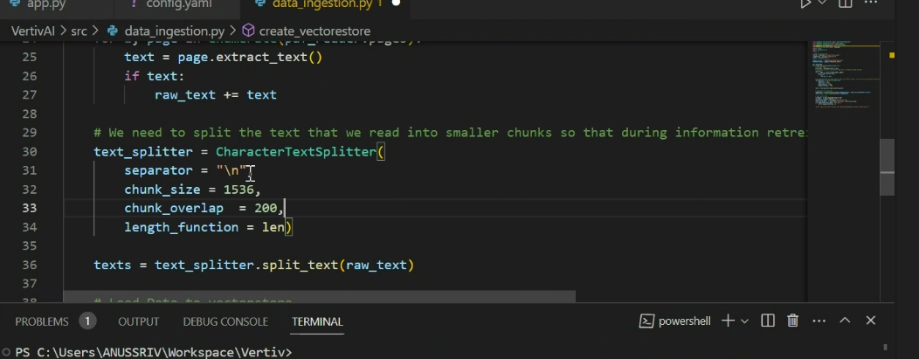
4096 is default token limitation. The flukeGPT model used 16000 tokens
Which must include Input chunk size, output and prompt
Chunk size i.e the maximum letters or words = 1536
Chunk overlap = 200 i.e max letters can be repeated in previous chunk and current chunk.

Slide 106
RAG - Retrieval-augmented generation is a technique that can provide more accurate results to queries than a generative large language model on its own because RAG uses knowledge external to data already contained in the LLM
Semantic search is a search engine technology that interprets the meaning of words and phrases. The results of a semantic search will return content matching the meaning of a query, as opposed to content that literally matches words in the query
TF-IDF/Term Frequency Technique: Easiest explanation for Text classification in NLP using Python (Chatbot training on words)
How the model is trained

Slide 107
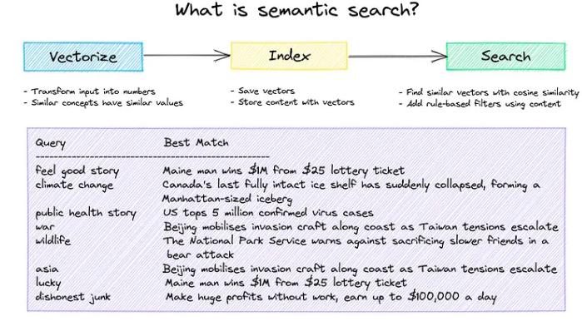
Getting started with semantic search | by David Mezzetti | NeuML | Medium

Slide 108
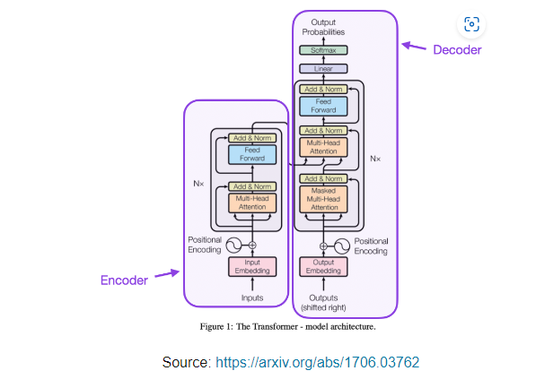
Understanding Large Language Models -- A Transformative Reading List (sebastianraschka.com)

Slide 109

[1706.03762] Attention Is All You Need (arxiv.org)

Slide 110


Slide 111


Slide 115
There is 95% of the respnoses are matching.
When

Slide 116



Slide 117

embeddings with Azure OpenAI
An embedding is a special format of data representation that can be easily utilized by machine learning models and algorithms. The embedding is an information dense representation of the semantic meaning of a piece of text. Each embedding is a vector of floating point numbers, such that the distance between two embeddings in the vector space is correlated with semantic similarity between two inputs in the original format. For example, if two texts are similar, then their vector representations should also be similar. Embeddings power vector similarity search in Azure Databases such as Azure Cosmos DB for MongoDB vCore.

Slide 118
AZURE_OPENAI_KEY="b70d5bb07ae74d4c9caf6e76dc9acf03"
AZURE_OPENAI_ENDPOINT="https://flukeflc.openai.azure.com/"
AZURE_OPENAI_API_TYPE ="azure"
AZURE_OPENAI_API_VERSION="2023-07-01-preview"
AZURE_OPENAI_DEPLOYMENT="GPT-16k"
AZURE_OPENAI_EMBEDDING_DEPLOYMENT ="FlukeSiteGPTTextEmbedding"
SEARCH_ENDPOINT="https://cog-flktsgpt-dev-eastus-001.search.windows.net"
SEARCH_API_KEY="h9Fyqubw7azDRMxQosXCog80dPDZUXy0O9hwV1tWmMAzSeBRAaRC"
AZURE_SEARCH_INDEX="flktsgptindexnonprod-comprehension"
AZURE_TENANT_ID="0f634ac3-b39f-41a6-83ba-8f107876c692"
AZURE_SUBSCRIPTION_ID="52a1d076-bbbf-422a-9bf7-95d61247be4b"
AZURE_SQL_ODBC_CONNECTIONSTRING="Driver={ODBC Driver 18 for SQL Server};Server=tcp:db-flktsgpt-dev-001.database.windows.net,1433;Database=dbase-flktsgpt-dev-001;Uid=flktsdevadmin;Pwd=f!ktsd@vAdmin;Encrypt=yes;TrustServerCertificate=no;Connection Timeout=30;"
What is text embedding, what is search index and what is cognitive search

Slide 119

https://learn.microsoft.com/en-us/training/browse/?terms=Generative%20AI

Slide 120
S.No | Issues/Best Practises | Description | Reference Link
1 | Embedding vs TF-IDF | Embedding is expensive and read the entire sentence as gets meaning and forms a vector TF-IDF reads at word level and generate vectors | https://medium.com/@tam.tamanna18/exploring-the-power-of-nlp-why-embeddings-usually-outperform-tf-idf-98742e7b0bce#:~:text=Unlike%20TF%2DIDF%2C%20which%20only,documents%20based%20on%20their%20content.
2 | Chunking prep.py Document-sync & asgi.py webserver | 5 sentences are made as one chunk. Top 10chunks selected based on search score are used as input
3 | Token Size | 16000 per minute which includes Top 10 question, chunks, Prompt and response
4 | Model process | The gpt triggers cognitive search. Cognitive search identifies the top 10 chunks, they are process along with the question, prompt and provide the answers
5 | GPT 3.5 vs GPT4 | GPT 3.5 : faster and less iexpensive GPT4 : very expensive and slower
6 | Cognitive search | Main components of Azure cognitive search are indexing and querying.
7 | Indexing prep.py Document-sync Asgi.py webserver | Chunks from the Azure-storage-sync will be saved in Cognitive search in the form of indexes. The Bot searches the indexes. Indexes with chunks are stored in Cognitive search
8 | The process of Chatbot | Question will be converted in to vector by GPT -> V1 The V1 will be input to Cognitive search. Cognitive search verifies the entire 26K pdfs. Cogsearch retrieves the top10 results based on the vector similarity score. Indexing will be done. Chunks Promts V1 Responses saved in SQL Cosmos DB | Where is indexing applied here and what it do
9 | Copy the files from Azure to Local system. | using code in vs code
10 | Convert them to parquet format to csv. | Using databricks
11 | Deploying the hot fix
12 | Rerun the 1100 test cases
13 | Validate the testcases
14 | Re validate the 10 which are not working

Slide 121


Slide 122
Fluke-URL
https://www.fluke.com/en-us/fluke/site-map
https://delphiapi-flkts-dev-eastus-001.azurewebsites.net/v2/chat/completions

Slide 123
Scope change :
Addition of new data sources and web scraping
Unit testing for all (1100) flukeGPT testcases
Deploy new version of code (Hotfix ) and retesting
DEV : 4-Dec-23 UAT : 14-Dec-23 PROD : 21-DEC-23

Slide 124

1. This has to be updated as per FlukeTechSupportGpt instead of KATA
2. I think this can be removed “Select prompt dropdown”
3. KATA & FORT to be replaced every where.

Slide 129
Current Challenges
Front end Ui integration support from Fortive
(Cullen 3 hours. Arshad 1 day)
Delay in support to create DEVOPS pipeline for UAT and Go-Live
that ui already we integrated with fluketsgpt, but that not working. that ui have lot of restrictions and issues. so they want to use new KATA UI

Slide 130
Delivery timelines
Support delay from Fortive on Front end.
Addition of new data sources and web scraping
Unit testing for all (1100) flukeGPT testcases
Milestone | End date | Remarks
AS-IS | 14-Nov-23 | Completed
DEV | 8-DEC-23 | Note : Delay in support from Fortive on front end support may lead to further change in timeline date.
UAT | 19-Dec-23 | UAT Sign Off
Go-Live | 25-DEC-23
* Deploy new version of code (Hotfix ) and retesting

Slide 131

Review on ROB test case report
Rob is to provide some clarifications on which pages the information is available
Getting issue related to safety. If it is Embedding it may resolve the issue, since it is TFIDF bot is directing to safety responses instead of product and services response

Slide 132
Front end setup completed for local
Backend setup completed for local
Front end and connection to Backend setup is in progress
From backend response is not getting to frontend UI-working on it
Need to complete
Backend response goes to frontend UI in local
frontend UI creation in Server(Azure)
Backend connection to Frontend in Server(Azure)
Testing UI- cases
Update the Frontend code to upload the question to database instead of local

